Slide 1

1. PHP Crash Course
(Internet Application Development)
Siva R Jasthi
ICS325 –Internet Application Development

Slide 2
Learning Objectives
Embedding PHP in HTML
Adding dynamic content
Accessing form variables
Understanding identifiers, variables, constants
Understanding variable scope
Understanding Operators and precedence
Evaluating expressions
Decisions with if, else, switch
Iterations with while, do, for loops

Slide 3
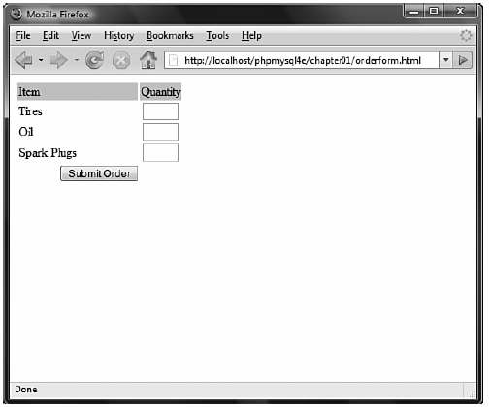
Learning through an example Bob’s Auto Parts
Let us review
Orderform.html
Processorder.php

Slide 4
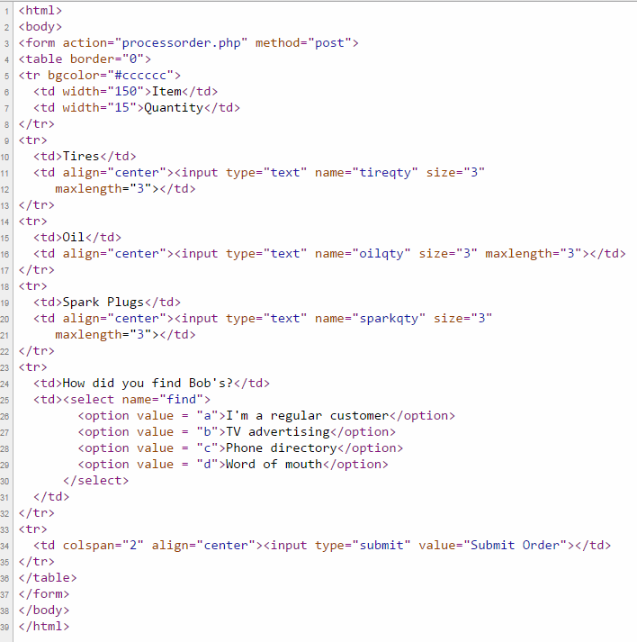
orderform.html

Slide 5
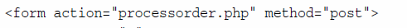
Submit action = processorder.php
The value of form submit action is set to “processorder.php”
In general, value of action attribute is the name of the URL that would be shown in the browser.
So, the PHP needs a way to fetch / get the values entered by the user in HTML form fields.
There are two methods the data is sent to the URL (as specified by method attribute)
POST: sent as a separate message
GET: Appended to the end of URL

Slide 6
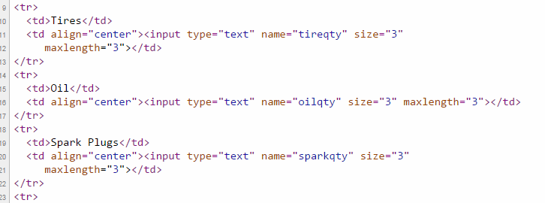
Submit action = processorder.php
“name” attribute of the form fields is important connection.
tireqty (Tire Quantity), oilqty (Oil Quantity), sparkqty (Spark Plugs Quantity)
The same values (of name attribute) will be used in PHP for further processing.
Give these variables meaningful names.
If you are using a HTML editor to write the HTML, the editors give “field1”, “field2” etc. names automatically. Those are NOT good names. Change those!

Slide 7
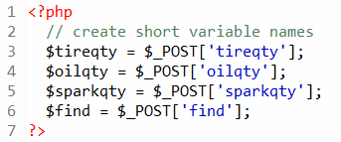
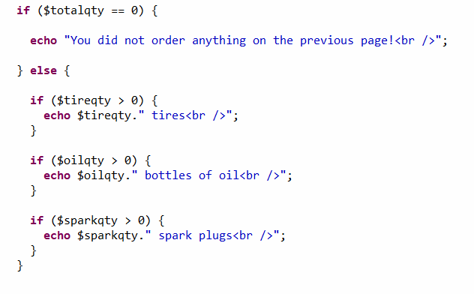

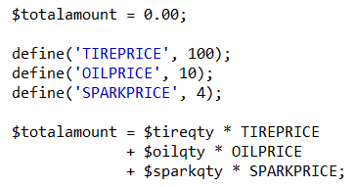
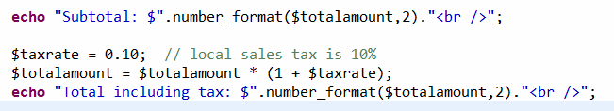
Processorder.php

Slide 8
What happens on the server side?
PHP is processed by the web server.
Plain HTML is sent back to the client (web browser).
If uses check the page through “View Source”, you can see that all PHP code is processed and the final page contains only HTML.
The client (web browser) understands HTML. And the client (web browser) doesn’t need to know about PHP.
That is the essence and beauty of server side scripting.
Client side technologies (such as JavaScript) require the client (browser) to know about JavaScript in addition to HTML.

Slide 9
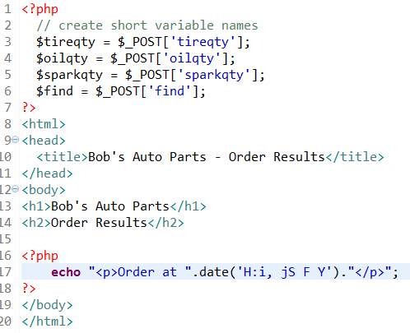
PHP Tags
All HTML tags start with < and end with >
<?php and ?> are special tags called “PHP Tags”.
Any code between PHP Tags is interpreted as PHP.
PHP Tags tell the web server where the PHP code starts and ends
Any code outside of PHP tags is interpreted as normal HTML.
HTML and PHP can appear in any order
PHP can produce HTML within PHP tags. (But not vice versa)

Slide 10
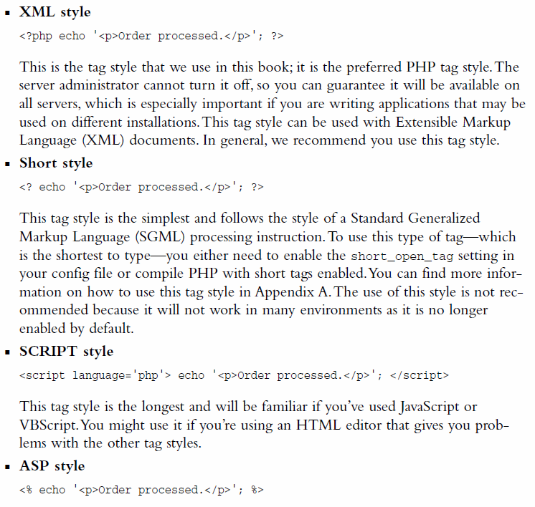

Different ways of PHP tagging
There are 4 different ways.
We will stick to XML way in this course.

Slide 11
PHP Statements
All PHP statements are separated by semi-colon ;
Similar to java or other programming languages.
Missing a ; leads to parsing error (in java, these are called compile errors).
Script stops executing at that point.
Note: Whitespaces are ignored in both HTML and PHP. Make liberal use of whitespace to improve the readability of your program.

Slide 12
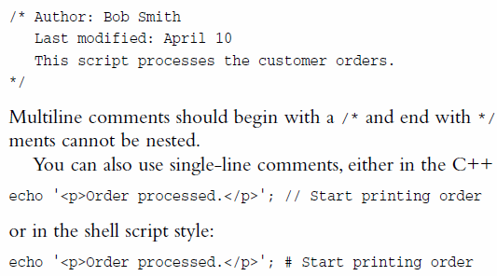
PHP Comments / Documentation
Block comment, C-Style, Multi-Line Comment
C++-Style, Single Line Comment
Scripting Style, Single Line Comment
With single line comments, anything after the PHP closing tag is interpreted as HTML.
Such coding style is discouraged. Comment as a full-line. Don’t mix with HTML.

Slide 13
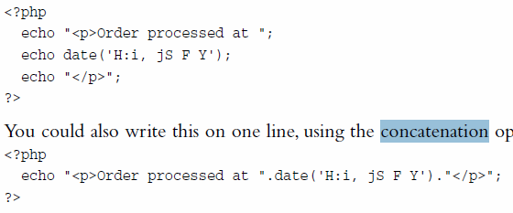
Concatenation Operator
Both these statements are equivalent.
. operator (dot operator) is useful in concatenating the strings.
date() is a built-in PHP function. Each time the script is run, it sends a different time stamp.

Slide 14

Accessing form variables
We will stick with medium style
Short style requires PHP configuration (register_globals setting to be turned on which is a security risk)
Long style is verbose and may be deprecated in the future versions.

Slide 15
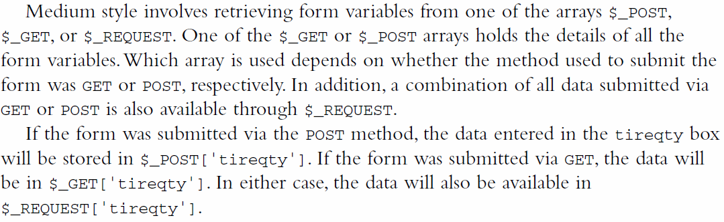
Accessing form variables
$_POST, $_GET, $_REQUEST are some of the superglobal arrays.

Slide 16
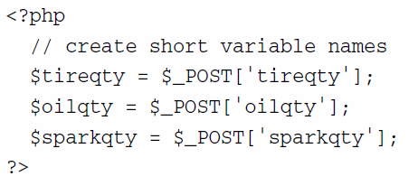
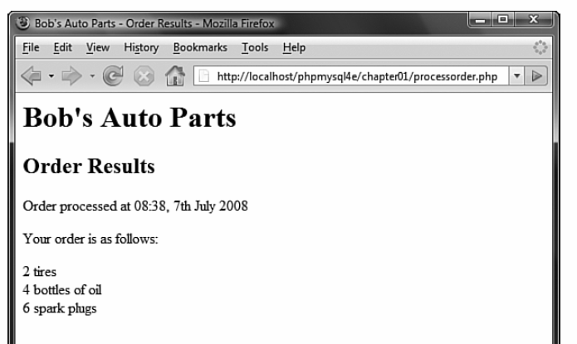
Accessing form variables (Contd.)
Accessing the form variables at the top of PHP script is a convention.
The above snippet is basically taking a form variable (through medium style convention and is assigning those values to variables on left.
LHS variables are PHP variables
RHS variables are Form / HTML variables.
These two names need not be the same, but is a convention to keep the same when possible.

Slide 17
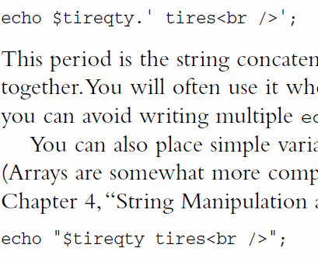

Single vs Double Quotes Interpolation
[1] String concatenation operator (dot operator)
[2] DOUBLE QUOTES. Variables are replaced with values. This process is called “Interpolation”. Slower than dot operator as processing is involved here.
[3] SINGLE QUOTES. Variables are NOT substituted. Everything in between single quotes is treated as a string literal

Slide 18
Understanding identifiers
Variable names, Function Names, Class Names – these are all identifiers.
CAUTION: variables are case sensitive. $tireqty is not same as $TireQty.
CAUTION: function names are NOT case sensitive. echo() and Echo() eChO() are all same.
CAUTION: variables and functions can have the same name, but should be avoided. Typically, variables are NOUNS and functions are VERBS. This distinction helps in readability.

Slide 19
PHP is a Loosely / weakly / dynamically Typed Language
<?php $x = 5; $y = 4; echo $x + $y; ?>
In this example, we did not have to tell PHP which data type the variable is.
PHP automatically converts the variable to the correct data type, depending on its value.
In other languages such as C, C++, and Java, the programmer must declare the name and type of the variable before using it.
<?php $x = 50; $x = “php”;
Echo $x.”v5”; ?>

Slide 20
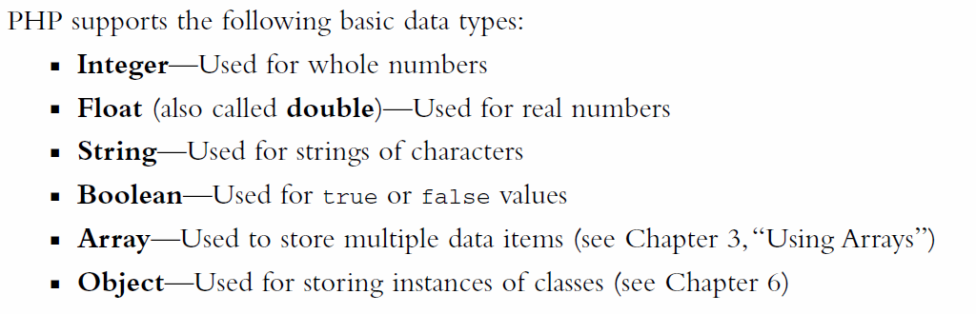
PHP Data Types - Basic

Slide 21
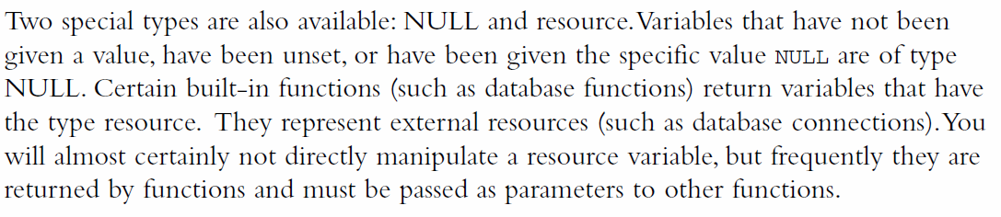
PHP Data Types – Other (NULL and resource)

Slide 22
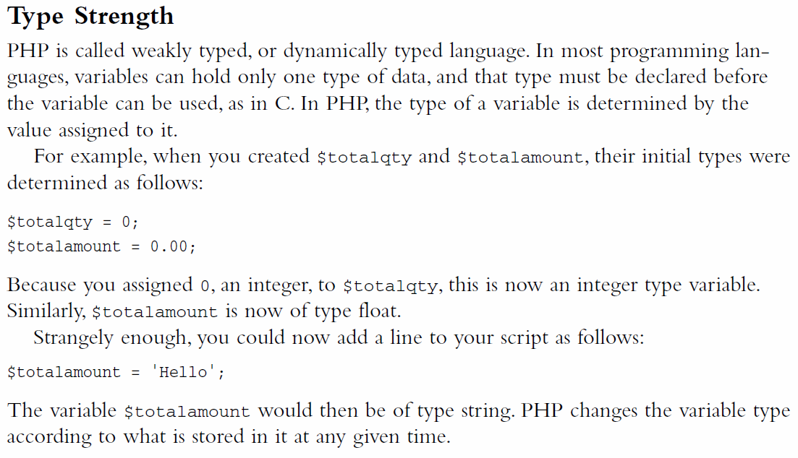
PHP is weakly typed or dynamically typed

Slide 23
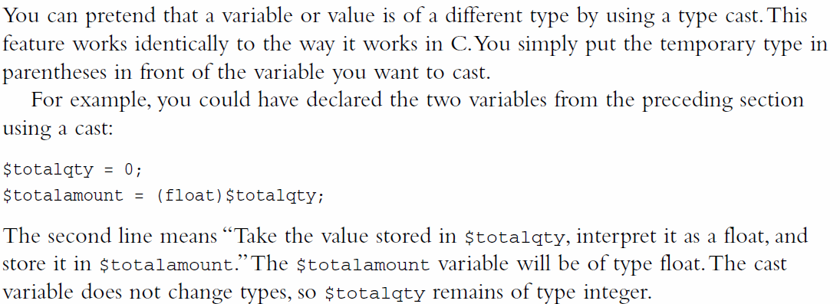
Type Casting of variables

Slide 24
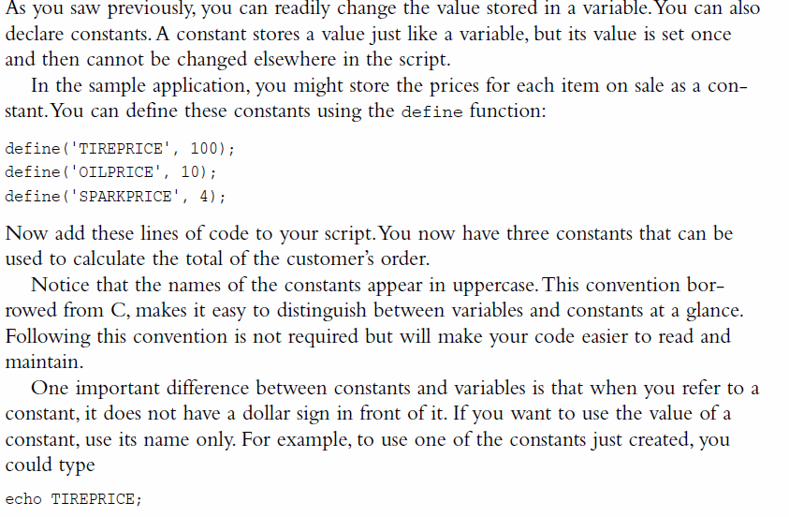
Declaring and using CONSTANTS

Slide 25
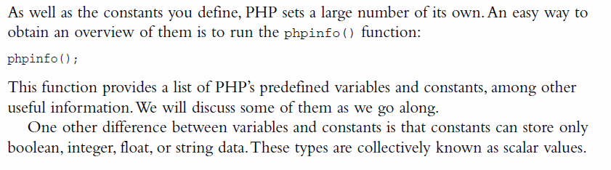
Declaring and using CONSTANTS (contd.)

Slide 26
Variable Scope - Rules
The native superglobals can be viewed anywhere in the program.
Constants can be used outside as well as inside functions, i.e., they have global visibility.
When you define a global variable in a script, that variable will have visibility in all areas of that script except for inside of functions within that same script.
Variables that get declared inside of functions as global will refer to the global variables that share the same name.
Static variables declared inside of functions can’t be seen outside of the function, but they do retain their value between function calls.
Plain vanilla variables inside of functions will be destroyed and unusable once the function has completed its execution.
The arrays $_GET and $_POST have special scope rules. They are the well known superglobals with visibility everywhere outside and inside of functions.

Slide 27
PHP Variable Scope
GLOBAL (outside the function; not visible to the function)
GLOBAL (outside the function, visible to the function if preceded by global keyword)
LOCAL (local to function; variables die after the function completes its execution; not visible anywhere else)
STATIC (variables declared inside the functions, but will retain the values after the function completes its execution)
SUPERGLOBALS: This is a 'superglobal', or automatic global, variable. This simply means that it is available in all scopes throughout a script. There is no need to do global $variable; to access it within functions or methods.
Let us see some examples here
http://php.net/manual/en/language.variables.scope.php

Slide 28
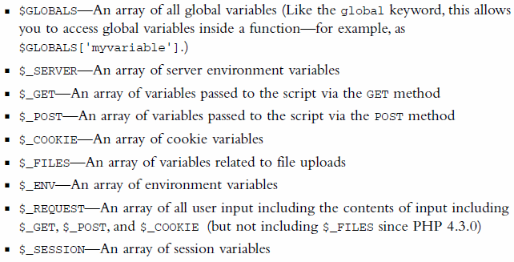
List of SUPER GLOBAL variables

Slide 29
Producing output: echo and print
echo and print are more or less the same. They are both used to output data to the screen.
The differences are small: echo has no return value while print has a return value of 1 so it can be used in expressions.
echo can take multiple parameters (although such usage is rare) while print can take one argument.
echo is marginally faster than print.

Slide 30
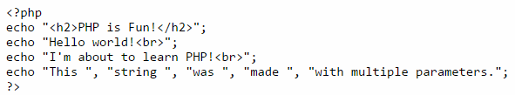
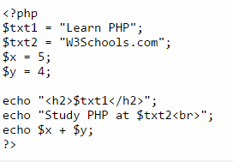

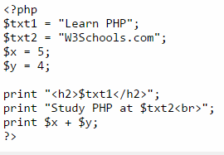
Producing output: echo and print

Slide 31
PHP Operators
We have already seen
= assignment operator
. (dot operator) Concatenation operator
All operators take 1, 2 or 3 arguments.
We will review this list now

Slide 32
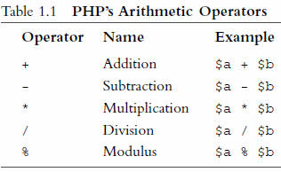
PHP Arithmetic Operators
Notes:
We have already seen
= assignment operator
. (dot operator) Concatenation operator
All operators take 1, 2 or 3 arguments.
/ (integer division)
% Modulus – Remainder operator

Slide 33
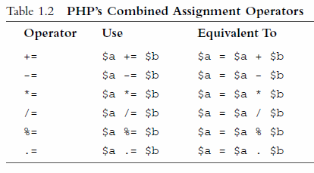
PHP Combined Assignment Operators
Notes:
We have already seen
= assignment operator
. (dot operator) Concatenation operator
All operators take 1, 2 or 3 arguments.
/ (integer division)
% Modulus – Remainder operator

Slide 34
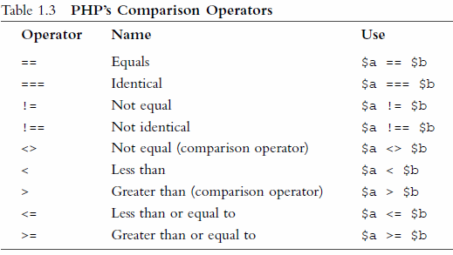
PHP Comparison Operators
Notes:
We have already seen
= assignment operator
. (dot operator) Concatenation operator
All operators take 1, 2 or 3 arguments.
/ (integer division)
% Modulus – Remainder operator

Slide 35
= and == operators → Logical Errors
CAUTION:
= is the assignment operator
== is the equality operator.
It is a common mistake (logical errors) to use
assignment in the place of equality.
So, one tip / technique is to use the following construct so that you don’t get into such logical error.
7 == $a is better option than $a==7
Notes:
We have already seen
= assignment operator
. (dot operator) Concatenation operator
All operators take 1, 2 or 3 arguments.
/ (integer division)
% Modulus – Remainder operator

Slide 36
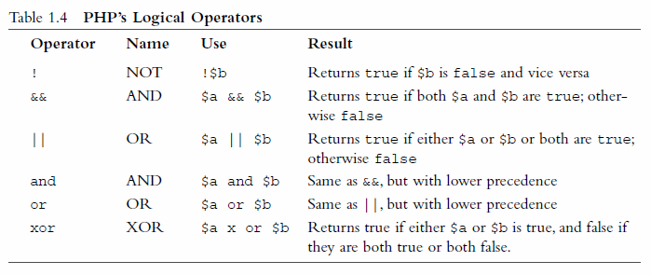
PHP’s Logical Operators
Notes:
We have already seen
= assignment operator
. (dot operator) Concatenation operator
All operators take 1, 2 or 3 arguments.
/ (integer division)
% Modulus – Remainder operator

Slide 37
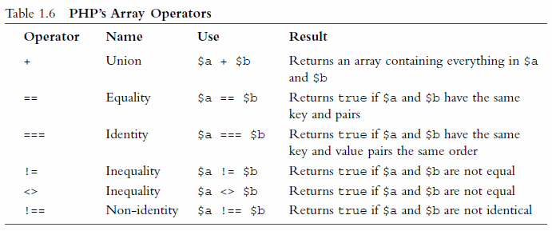
PHP’s Array Operators
Notes:
We have already seen
= assignment operator
. (dot operator) Concatenation operator
All operators take 1, 2 or 3 arguments.
/ (integer division)
% Modulus – Remainder operator

Slide 38
Other Operators
Comma Operator
To separate the function arguments
New
To create PHP objects
→
To reference variables of PHP objects
(@) Error Suppression Operator
$a = @ (57/x); // if x = 0, the error is suppressed
Ternary operator (?)
condition ? value if true : value if false
Execution operator (pair of backticks)
$out = `dir c:`;
Type or instanceof operator
Notes:
We have already seen
= assignment operator
. (dot operator) Concatenation operator
All operators take 1, 2 or 3 arguments.
/ (integer division)
% Modulus – Remainder operator

Slide 39

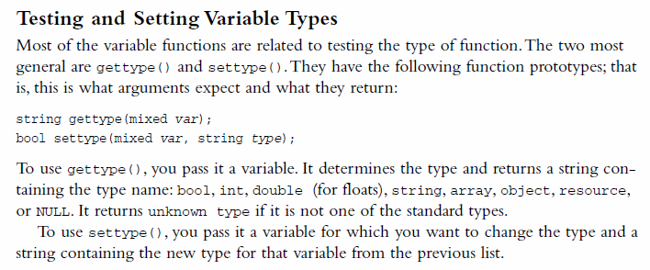
Getting and Setting Variable Type
Notes:
We have already seen
= assignment operator
. (dot operator) Concatenation operator
All operators take 1, 2 or 3 arguments.
/ (integer division)
% Modulus – Remainder operator

Slide 40
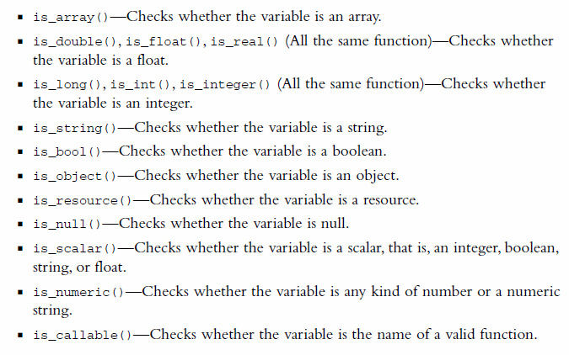
PHP Type Testing Functions
Notes:
We have already seen
= assignment operator
. (dot operator) Concatenation operator
All operators take 1, 2 or 3 arguments.
/ (integer division)
% Modulus – Remainder operator

Slide 41
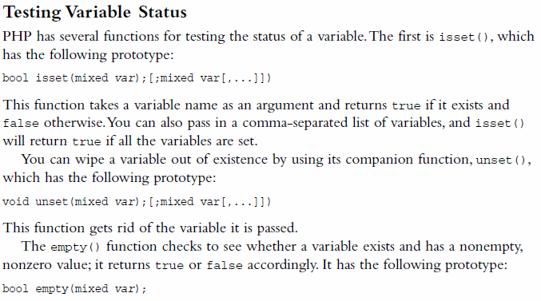
Testing Variable Status (very useful in web)
Notes:
We have already seen
= assignment operator
. (dot operator) Concatenation operator
All operators take 1, 2 or 3 arguments.
/ (integer division)
% Modulus – Remainder operator

Slide 42
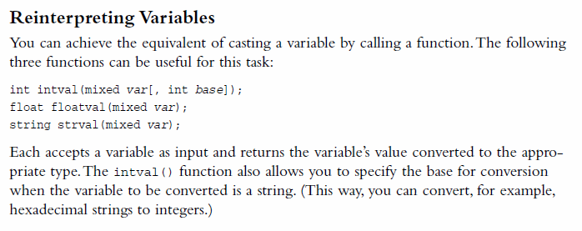
Casting vs Reinterpreting
Notes:
We have already seen
= assignment operator
. (dot operator) Concatenation operator
All operators take 1, 2 or 3 arguments.
/ (integer division)
% Modulus – Remainder operator

Slide 43
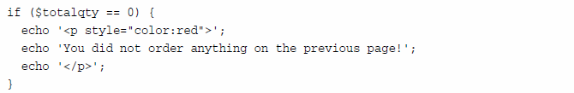
Decision Making - if
Notes:
We have already seen
= assignment operator
. (dot operator) Concatenation operator
All operators take 1, 2 or 3 arguments.
/ (integer division)
% Modulus – Remainder operator

Slide 44
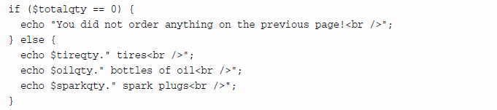
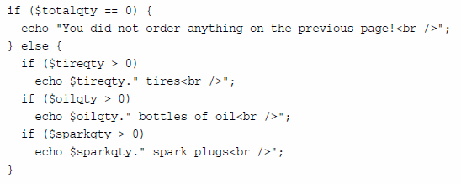
Decision Making – if .. else
Notes:
We have already seen
= assignment operator
. (dot operator) Concatenation operator
All operators take 1, 2 or 3 arguments.
/ (integer division)
% Modulus – Remainder operator

Slide 45
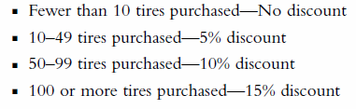
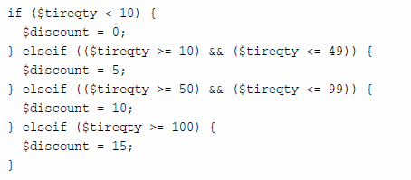
Decision Making – if .. elseif
Notes:
We have already seen
= assignment operator
. (dot operator) Concatenation operator
All operators take 1, 2 or 3 arguments.
/ (integer division)
% Modulus – Remainder operator

Slide 46
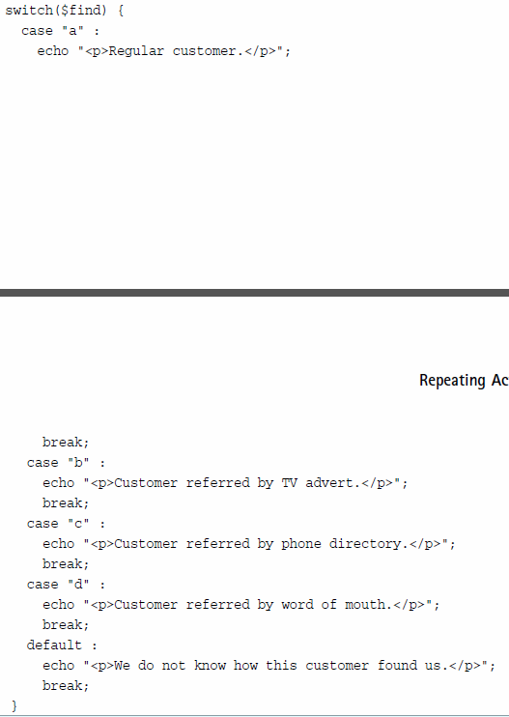
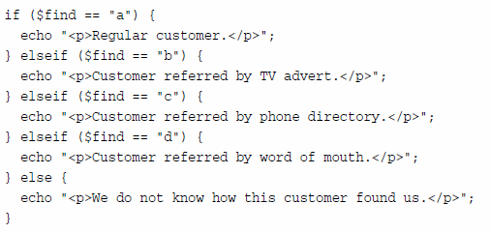
Decision Making – switch
If condition is evaluated only
to TRUE or FALSE;
Swich can branch based on
any scalar value.
Notes:
We have already seen
= assignment operator
. (dot operator) Concatenation operator
All operators take 1, 2 or 3 arguments.
/ (integer division)
% Modulus – Remainder operator

Slide 47

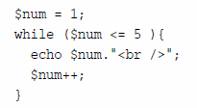
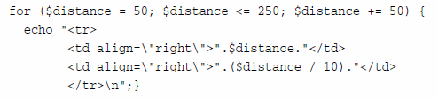
Iterations: 3 ways while; do .. while; for
Notes:
We have already seen
= assignment operator
. (dot operator) Concatenation operator
All operators take 1, 2 or 3 arguments.
/ (integer division)
% Modulus – Remainder operator

Slide 48
Breaking out of iterations or script
Break: for breaking out of the loop and starting at the line outside of the loop
Continue: for stopping the loop and continuing the loop at next iteration
Exit: for stopping the entire script and exiting out of the script
Notes:
We have already seen
= assignment operator
. (dot operator) Concatenation operator
All operators take 1, 2 or 3 arguments.
/ (integer division)
% Modulus – Remainder operator

Slide 49
Summary
[1] Loosely/ Weakly / Dynamically Typed Language
[2] Most of the constructs are similar to java or C
[3] Be familiar with
Data types
Variable Scope
Arithmetic, Comparison, Logical Operations
Conditional Branching
Iterations / Loops
[4] And DON’T forget to put $ for variables and ; to terminate the PHP statements.
Notes:
We have already seen
= assignment operator
. (dot operator) Concatenation operator
All operators take 1, 2 or 3 arguments.
/ (integer division)
% Modulus – Remainder operator

